Slide 1

FINAL PROJECT
PROJECT TITLE
Prediction of the selling price of the used cars
Name : PAVAN KANTH KATTIKAM
Campus id : UW753356
Subject : Machine Learning

Slide 2
Introduction
Creating the models that can precisely anticipate a used car's selling price based on its attributes is necessary to predict the sale price of used automobiles. The goal is to develop the prediction models that would help prospective auto buyers and sellers choose a fair and acceptable asking price for a used car.
The precise estimation of the sale price will help individual sellers establish a fair and competitive price for their cars, but it will also provide prospective purchasers the information they need to make judgments based on the anticipated market worth.
Additionally, this predictive models will be a useful tool for used vehicle dealers, financial institutions, and other industry participants to simplify operations, improve pricing tactics, and boost customer satisfaction.
As a result, there are frequently differences between the quoted price and the real market value, causing both parties to be dissatisfied and suffer financial losses.
This project intends to develop a trustworthy and effective solution that supports the openness, equity, and efficiency of the used automobile market by tackling the problem of anticipating the sale price of used cars.

Slide 3
Training Dataset Overview
We will use the Car Dekho dataset from Kaggle, which contains information about the used cars listed on the CarDekho website. The dataset contains 4340 rows and 8 columns.
Attribute Information:
name: The brand and model of the car
year: The year in which the car was manufactured
selling_price: The price at which the car is being sold (target variable)
km_driven: The distance traveled by the car in kilometers
fuel: The type of fuel used by the car (Petrol, Diesel, CNG, LPG, Electric)
seller_type: The type of seller (Individual, Dealer, Trustmark Dealer)
transmission: The type of transmission (Manual, Automatic)
owner: The number of previous owners of the car (0, 1, 2, 3, 4)

Slide 4
Testing Dataset Overview
We will be using the New Used cars price prediction from the Kaggle website on the trained models. The dataset contains the features which are different from the trained dataset. By preprocessing the new dataset, Using the feature extraction techniques the test data is modified like the trained dataset.
The dataset contains 4340 rows and 8 columns.
Attribute Information:
name: The brand and model of the car
year: The year in which the car was manufactured
selling_price: The price at which the car is being sold (target variable)
km_driven: The distance traveled by the car in kilometers
fuel: The type of fuel used by the car (Petrol, Diesel, CNG, LPG, Electric)
seller_type: The type of seller (Individual, Dealer, Trustmark Dealer)
transmission: The type of transmission (Manual, Automatic)
owner: The number of previous owners of the car (0, 1, 2, 3, 4)

Slide 5
Preprocessing and EDA
Firstly, I have found the null values in the dataset and then I dropped all of the null values.
Encoded all the Categorical features into integers in the features columns.
Calculated the correlation coefficients between numerical columns in the data frame, providing insights into their linear relationships.
Finally, splitted the dataset as the train and test sets for the training of the models in the 80 and 20 ratio.
First, we preprocess the data and then split the data into train and testing datasets. Next, we develop a linear regression model and fit the train data and made the visualizations then tried to predict the prices of both the train and test data.

Slide 6
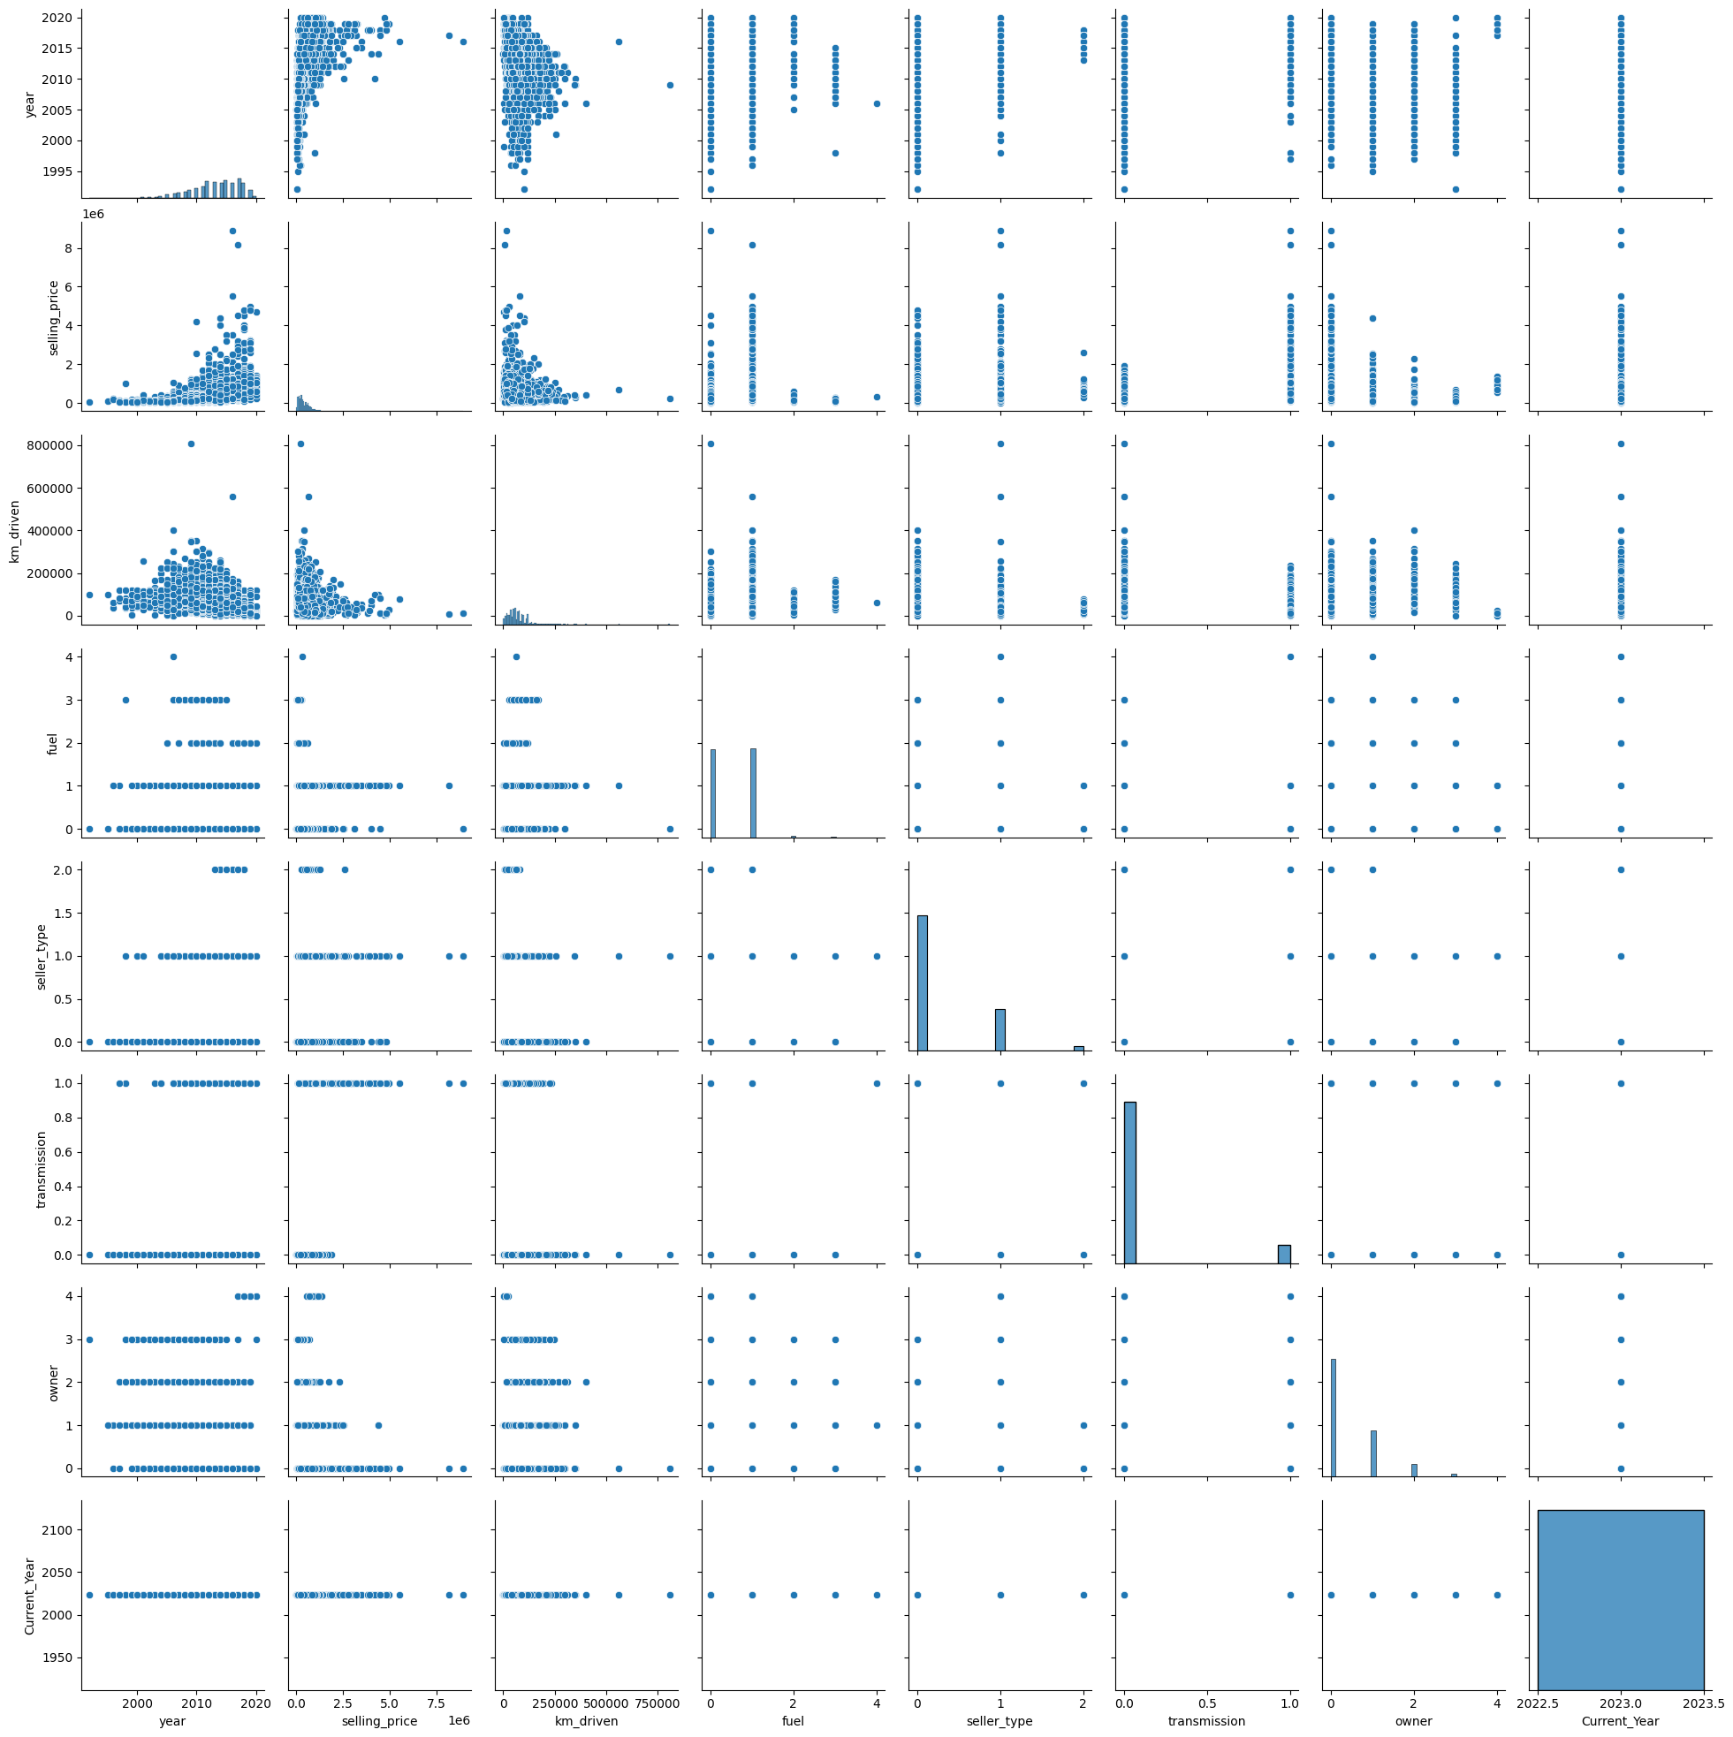
Distribution of Variables

Slide 7
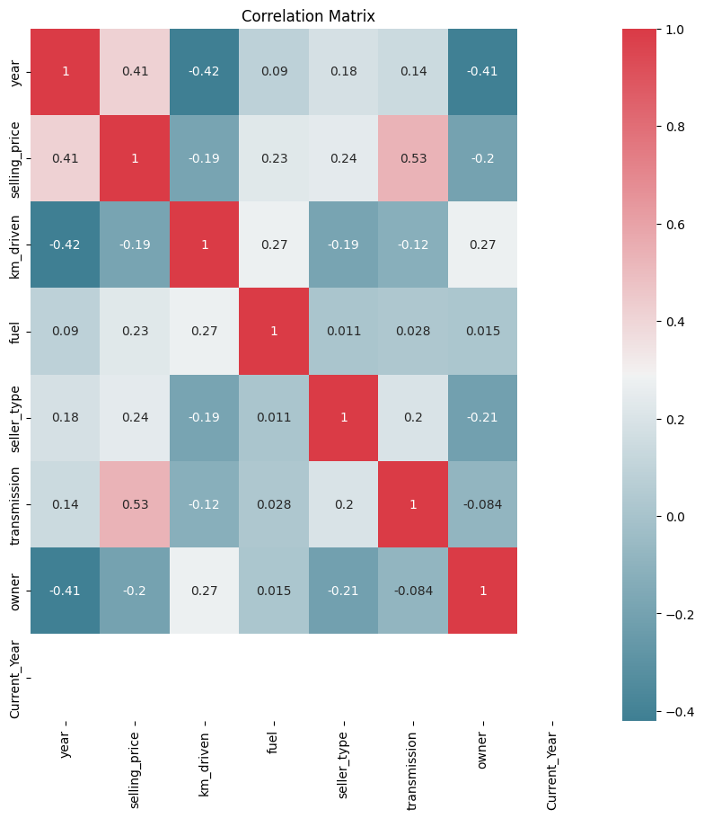
Correlation Matrix

Slide 8
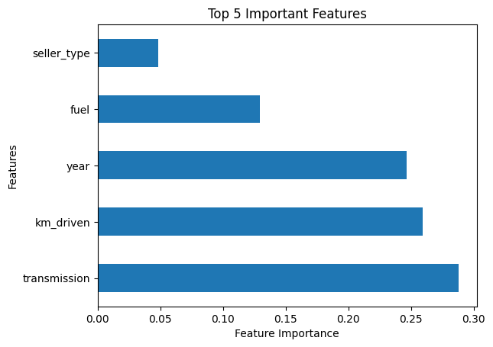
Predicting top 5 important features using the Extra trees regressor model

Slide 9
Implementing the models based on the trained dataset
I used various models to predict the prices of used cars based on the dataset I took from Kaggle.
Linear Regression Model
Lasso Regression Model
Neural Network Regression Model
XG boost regression model
Lg boost regression model
Random forest regression model
Cat boost regression model

Slide 10
Metric scores of all the models
No | Linear Regression | Lasso Regression Model | Neural Network | XG boost | Lg boost | Random forest | Cat Boost
MSE | 140808057982.91498 | 140808003490.73047 | 230742055006.37274 | 104700367546.30898 | 110635294991.2816 | 110487449216.7591 | 96898855859.70512
R-Squared | 0.4145442614994346 | 0.41454448806858535 | 0.04061413705964778 | 0.5646738412474768 | 0.539997431530461 | 0.5406121488864646 | 0.5971111878832469
MAE | 375243.9979305665 | 237828.71376885386 | 295178.7163174943 | 172123.80192843865 | 184679.25311579843 | 176087.39427190885 | 178223.05729409613
RMSE | 237828.78953927686 | 375243.92532155727 | 480356.17515170213 | 323574.3616949726 | 332618.84340981283 | 332396.52407442394 | 311285.8105659574

Slide 11
Model Evaluations on Dataset
Based on the scores of all the models Cat_Boost and XG_Boost got the highest R-2 scores of 59.7% and 56.4%.
These two models will predict the better prices of the used cars when compared to the other models.
The other five models have the predictions but not better than Cat_Boost and XG_Boost.
These two models are chosen to predict the prices of the new dataset of housing prices for the next steps.
Both the models have predicted the prices of the new dataset.

Slide 12
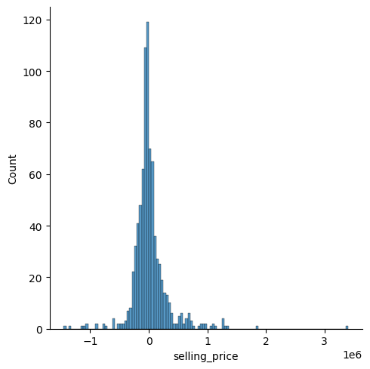
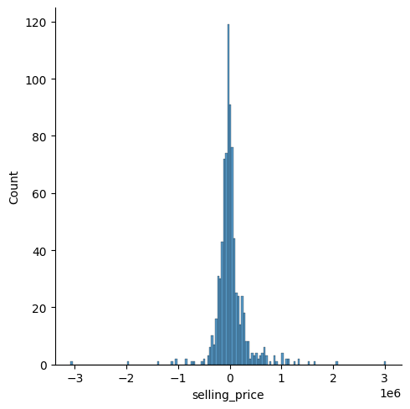
Cat_boost vs XG_boost predictions
Cat_Boost
Xg_Boost

Slide 13
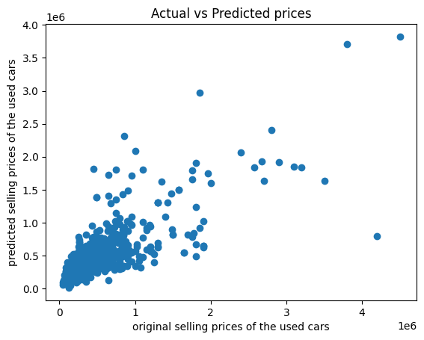
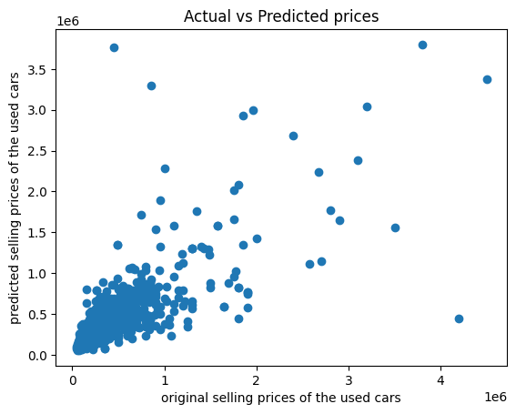
Cat_boost vs XG_boost predictions
Cat_Boost
Xg_Boost

Slide 14
Implementing the models on the New dataset
A new dataset has been chosen from the Kaggle website which has same features as the trained dataset.
All the EDA and preprocessing techniques are applied on the new dataset and made the features similar to the trained dataset.
All the attributes and the number of input features given to the models need to be same as the trained dataset for the proper implementation of the models and the accurate predictions of the housing prices.
Some of the features in the dataset has been interchanged based on their order same as the trained dataset

Slide 15
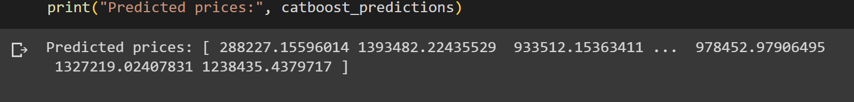
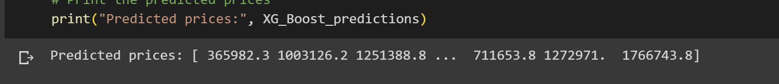
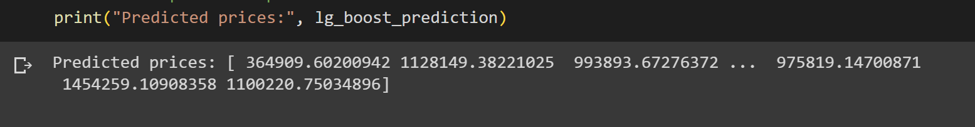
Final Predictions of the models on the new dataset
Prediction of the prices by cat_boost model.
Prediction of the prices by Xg_boost model.
Prediction of the prices by Xg_boost model.

Slide 16
REFERENCES:
[1] https://www.kaggle.com/datasets/nehalbirla/vehicle-dataset-from-cardekho?select=CAR+DETAILS+FROM+CAR+DEKHO.csv
[2] https://medium.com/odscjournal/predicting-car-prices-using-machine-learning-and-data-science-52ed44abab1b
[3] https://www.kaggle.com/code/gauravduttakiit/car-price-prediction-using-lasso-regression
[4] https://www.kaggle.com/datasets/avikasliwal/used-cars-price-prediction?select=train-data.csv
[5] https://github.com/agusabdulrahman/Car-Price-Prediction/blob/main/Car_Price_Prediction.ipynb
[6] https://towardsdatascience.com/catboost-vs-lightgbm-vs-xgboost-c80f40662924

